Slide 1
Module 7 Project selection (Part 1)
Mgmt 6054 project strategic management

Slide 2
Module agenda
Project Selection (continued from module 6)
Payback period analysis (2 approaches)
Net present value
Homework/evaluations

Slide 3
Project selection process
Project (or projects) being considered
Feasibility study
Benefit-to-cost analysis
CAN the project be done? Covered previously. Is the project viable, practical, and achievable?
SHOULD the project be done? Consider net present value, cash flows, rate of return, probability of success, reality of assumptions and constraints

Slide 4
Project selection benefit-to-cost (Financial) analysis
Financial analysis of projects using different methods:
Payback period analysis
Discounted payback period analysis
Net present value (NPV) analysis
Internal rate of return (IRR)
Benefit - Cost Analysis (BCA)
Today
Module 8

Slide 5

1. Payback Period analysis
The period of time needed for an organization to recover its initial investment, based on cash inflows
Does not incorporate time value of money
Not very accurate but universally known and used
Answer is measured in unit of time
Quick calculations
A form of a “Ball park estimate”
Notes:
Image https://www.baseballpilgrimages.com/national/cincinnati.html

Slide 6
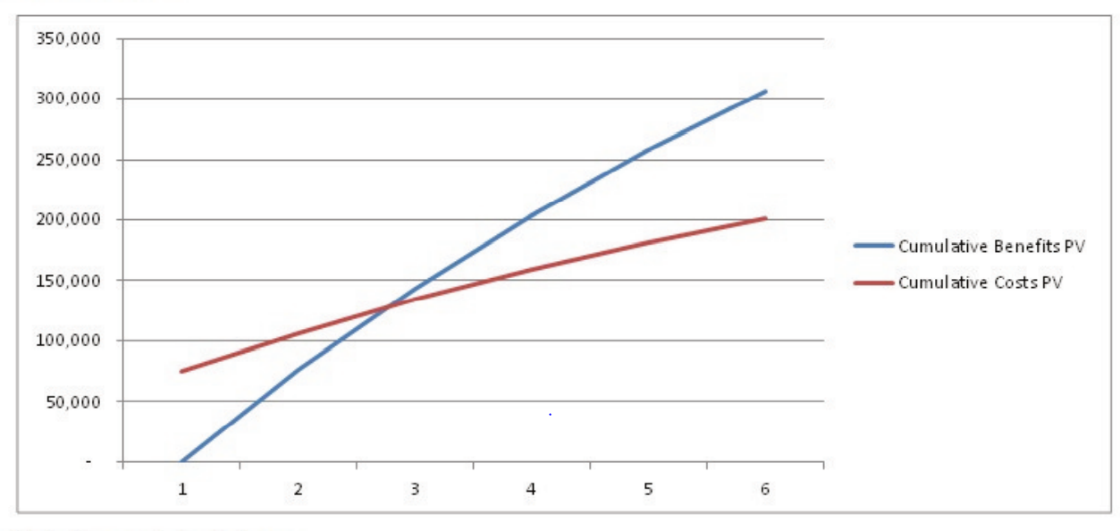
1. Payback Period analysis
The point after which the benefits start to outweigh the costs
Notes:
See reference slide re image

Slide 7
1. Payback Period analysis
This five-year project is expected to take four years to pay back the original investment using cash inflows. We initially spend $10K, and it will take up to year 4 to receive the $10K back.

Slide 8
1. Payback Period analysis Steady Cash inflows
Example:
Project A has an initial investment of $600,000 and expected project cash inflows of $240,000 for 4 years (staring with the end of year one). Project B has an initial investment of $375,000 and expected project cash inflows of $120,000 for 5 years.
What is the payback period for Project A?
What is the payback period for Project B?
Considering only payback period analysis, which project is preferred, and why?
Perform this exercise before moving to the next slide.
Draw a couple of simple timelines on a piece of paper (or use Excel columns) to visualize these 2 projects and calculate the payback periods.

Slide 9
1. Payback Period analysis Steady Cash inflows
Example:
Project A has an initial investment of $600,000 and expected project cash inflows of $240,000 for 4 years. Project B has an initial investment of $375,000 and expected project cash inflows of $120,000 for 5 years.
What is the payback period for Project A?
What is the payback period for Project B?
Considering only payback period analysis, which project is preferred, and why?
240
240
240
240
PP_{A}= 600/240 = 2.5y
0
1
2
3
4
Inflow +ve
A
Outflow -ve
600
120
120
120
120
120
PP_{B}= 375/120 = 3.1y
0
1
2
3
4
5
Inflow +ve
B
Outflow -ve
375

Slide 10
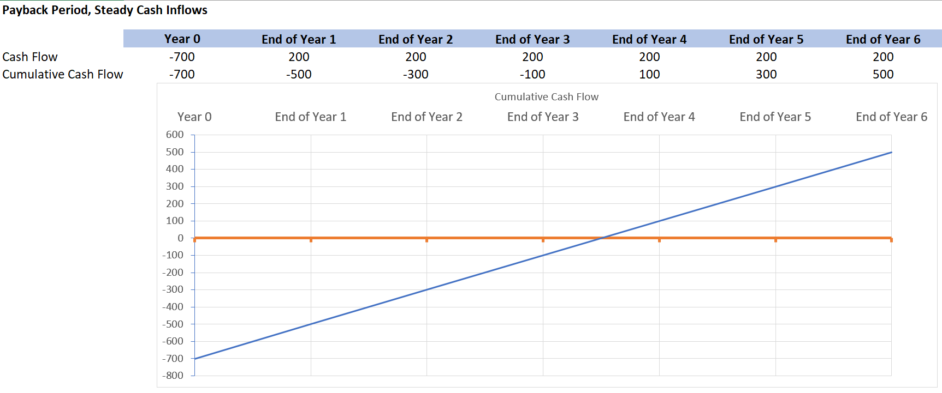
1. Payback Period analysis Steady Cash inflows
An example of cumulative cash flow curve (blue line) when we have steady cash inflows. Note the curve is a straight line. If we say the payback period is 3.5 years, we are interpolating between years 3 and 4. We are assuming that the year 4 cash inflow is being received throughout year 4 rather than just at the end of year 4.

Slide 11
1. Payback Period analysis Cash inflows Vary
Modified example:
What if the cash inflows varied?
Project A has an initial investment of $600,000 and expected project cash inflows of $240,000 for 2 years, followed by cash inflows of $210,000 for 2 years. Project B has an initial investment of $375,000 and expected project cash inflows of $120,000 for the first year and cash inflows of $130,000 for the remaining 4 years.
What is the payback period for Project A?
What is the payback period for Project B?
Considering only payback period analysis, which project is preferred, and why?
Perform this exercise before moving to the next slide.
Draw a couple of simple timelines on a piece of paper (or use Excel columns) to visualize these 2 projects and calculate the payback periods.

Slide 12
1. Payback Period analysis Cash inflows Vary
Modified example: What if the cash inflows varied? Project A has an initial investment of $600,000 and expected project cash inflows of $240,000 for 2 years, followed by cash inflows of $210,000 for 2 years. Project B has an initial investment of $375,000 and expected project cash inflows of $120,000 for the first year and cash inflows of $130,000 for the remaining 4 years. a) What is the payback period for Project A? b) What is the payback period for Project B? c) Considering only payback period analysis, which project is preferred, and why?
240
240
210
210
Let’s use Excel, see the next slide
0
1
2
3
4
Inflow +ve
A
Outflow -ve
600
120
130
130
130
130
0
1
2
3
4
5
Inflow +ve
B
Outflow -ve
375

Slide 13
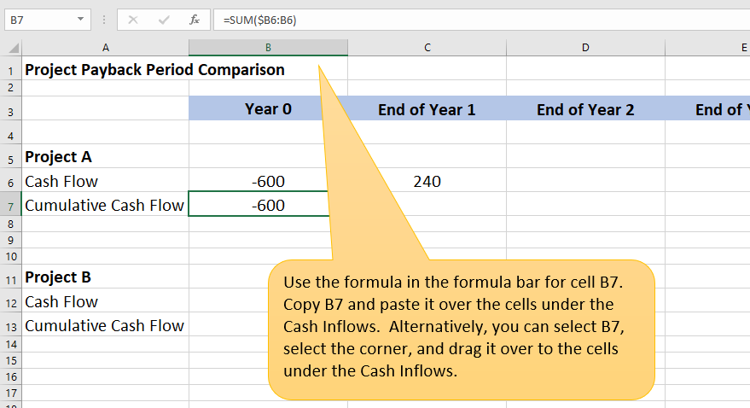
1. Payback Period analysis Cash inflows VARY
Use the following example to perform a payback period analysis for the 2 projects in the previous slide. You’ll be creating “cumulative cash flow” rows for both projects. Use interpolation to determine partial years in your payback period. Also compare the total cumulative cash flows in both investments, and the total durations of the investments.

Slide 14
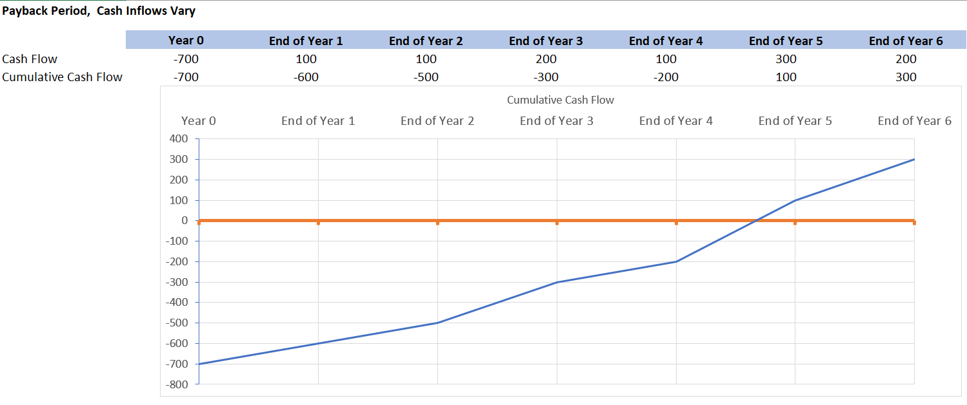
1. Payback Period analysis Cash inflows VARY
An example of cumulative cash flow curve (blue line) when cash inflows vary Note the curve is NOT a straight line. We can interpolate the payback period of 4.66 years or 4 years 8 months. We need 200 of the 300 dollars in year 5 to get to get our cumulative curve to the zero (orange) line. 200/300 = 0.66, so we interpolate 2/3 of year 5 (equal to 8 months).

Slide 15
Discounted Payback Period (DPP) analysis
Although we’ve been using a payback period that ignores the time value of money, a Discounted Payback Period can be used that does. In the example below, if we used a 10% discount rate for scenario B, the payback period would change from 2 years to more than 2 years. A DPP will result in a longer payback period.
100
100
100
Payback Period
0
1
2
3
Inflow +ve
By end of year 2 we have recovered our 200 investment.
A
Outflow -ve
200
Discounted Payback Period (DPP)
90.9
82.6
75.1
Using DPP, our 100 inflow for year 1 is discounted by 10%. 100/(1+10%) = 90.9. By end of year 2 we have only recovered 90.9 + 82.6 = 173.5. By year 3 we recovered 173.5 + 75.1= 248.6
Discount the cash inflows using a 10% discount rate. Draw a diagram similar to the one above but use discounted cash inflow numbers. Determine the approximate payback period, then move this graphic aside to reveal the answers!
0
1
2
3
Inflow +ve
B
Outflow -ve
Year 3
200
Our DPP is sometime in year 3, definitely before the end of year 3.

Slide 16
2. Net present value (NPV) aNALYSIS
Net (cash inflow minus outflow)
Present (value today)
Value (quantitative)
Benefits of NPV:
It is a much more useful calculation than payback period.
Uses the ‘time value of money’ to standardize project outcomes.
Projects can be compared (ranked) directly, even with differing investment patterns and project length.
Evaluates cash flows of a project for each time period of the project horizon.

Slide 17

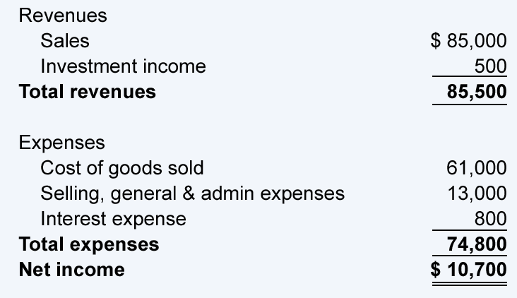
2. Net Present value “net”
“Net” income is your financial standing (in your account) after considering all cash inflows (revenues, income) and outflows (expenses).
Similarly, “Net” Present Value (NPV) is the sum of present value of all cash inflows and outflows.
Notes:
Image pngimg.com

Slide 18
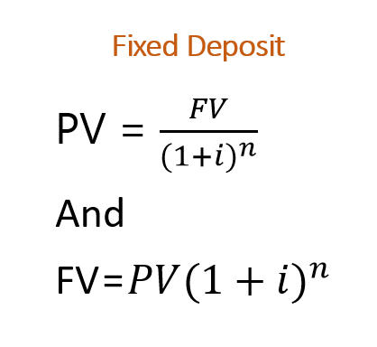
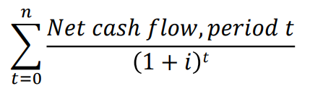
2. Net present value
Where:
PV = Present Value
r = interest/discount rate
NPV = Net Present Value
r
NPV =
r
If… | It means… | Then…
NPV > 0 | …the investment would add value to the organization | …the project may be accepted.
NPV < 0 | …the investment would subtract value from the organization | …the project should be rejected.
NPV = 0 | …the investment would neither gain nor lose value for the organization | …decision should be based on other criteria or considerations (e.g., strategic positioning or other factors not explicitly included in the calculation).

Slide 19
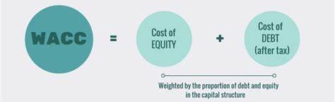

2. Net present value Discount/interest rate
The value of r, which is the (discount/interest rate), has a big impact on the NPV calculation.
How do we determine r?
NPV =
r
?
r=
The weighted average cost of capital (WACC)
Note, a weighted average
Notes:
We won’t be going into the details on how to calculate a WACC but this link provides more information including a more detailed formula https://www.investopedia.com/terms/w/wacc.asp#:~:text=WACC%20is%20calculated%20by%20multiplying,in%20discounted%20cash%20flow%20analysis.

Slide 20
Project Return on investment (ROI)
ROI – the project financial “profit” as a percentage of the total project cost. Per an earlier example, if our project cost was 200 and we had an inflow of 300, our ROI is (300-200)/200 or 100/200 or 50%
100
100
100
0
1
2
3
Inflow +ve
A
Outflow -ve
200
Discounted ROI – similar but discounting for time value of money via NPV (90.9+82.6+75.1 - 200)/200 = (248.6-200)/200 = 48.6/200 =24.3%
90.9
82.6
75.1
0
1
2
3
Inflow +ve
B
Outflow -ve
200
10% discount rate

Slide 21
2. Net present value Example - terminology
You have a project with an initial investment of $800k. It is expected to provide a payback over 3 years, and will contribute an additional $450k in cash flow per year. It must achieve at least 15% return on investment.
a : what is the initial investment?
b : for how many years will the project have an impact?
c : will the cash flow increase per year (e.g. inflation)?
d : what discount/interest rate should I use?
e : draw the timeline with cashflows
450
450
450
0
1
2
3
Inflow +ve
Outflow -ve
800

Slide 22
2. Net present value Example - terminology
You have a project with an initial investment of $800k. It is expected to provide a payback over 3 years, and will contribute an additional $450k in cash flow per year. It must achieve at least 15% return on investment.
450 discounted 1 year is 450/(1.15^1)
450 discounted 2 years is 450/(1.15^2)
450 discounted 3 years is 450/(1.15^3)
391.3
340.3
295.9
0
1
2
3
Inflow +ve
Outflow -ve
800
So the cumulative cashflow is -800+391.3+340.3+295.9 = 227.5
And since this is greater than zero, the return is more than 15%.

Slide 23
2. Net present value example comparing two projects
Let’s assess two projects with net present value (assume 15% discount/interest rate).
Project A has an initial investment of $700,000 and project cash inflows of $225,000 for 5 years
Project B an initial investment of $400,000 and project cash inflows of $110,000 for 5 years
n = ?
r = ?
NPV =
r

Slide 24
2. Net present value example comparing two projects
Let’s assess two projects with net present value (assume 15% discount/interest rate).
Project A has an initial investment of $700,000 and project cash inflows of $225,000 for 5 years
Project B an initial investment of $400,000 and project cash inflows of $110,000 for 5 years
225
225
225
225
225
A
0
1
2
3
4
5
Inflow +ve
Outflow -ve
700
$NPV A=−\$700,000+\frac{\$225,000}{{\left(1+.15\right)}^{1}}+\frac{\$225,000}{{\left(1+.15\right)}^{2}}+\frac{\$225,000}{{\left(1+.15\right)}^{3}}+\frac{\$225,000}{{\left(1+.15\right)}^{4}}$ $+\frac{\$225,000}{{\left(1+.15\right)}^{5}}=\$54,234$
$NPV B=−\$400,000+\frac{\$110,000}{{\left(1+.15\right)}^{1}}+\frac{\$110,000}{{\left(1+.15\right)}^{2}}+\frac{\$110,000}{{\left(1+.15\right)}^{3}}+\frac{\$110,000}{{\left(1+.15\right)}^{4}}$ $+\frac{\$110,000}{{\left(1+.15\right)}^{5}}=− \$31,263$

Slide 25
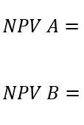
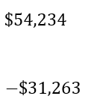
2. Net present value example comparing two projects
What do the NPV calculations tell us about these two projects?
Make sure you noticed in the last slide that the NPV of Project B was negative
If… | It means… | Then…
NPV > 0 | …the investment would add value to the organization | …the project may be accepted.
NPV < 0 | …the investment would subtract value from the organization | …the project should be rejected.
NPV = 0 | …the investment would neither gain nor lose value for the organization | …decision should be based on other criteria (e.g., strategic positioning or other factors not explicitly included in the calculation).

Slide 26
2. Net present value Example with multiple outflows
275
275
New equipment costs $250k.
Two years to implement the project, costing $100k the first year, $50k the second year.
Estimated cash flow return (inflow) is $275k in year 1 and year 2.
Discount rate is 5%.
What is the NPV for this project?
0
1
2
250
100
50
NPV = -250 + 275-100 + 275 – 50
(1+0.05)¹ (1+0.05)²
= -250 + 175 + 225
1.05 1.1025
= -250 + 166.67 + 204.08
= 120.75 → $120,750
NPV = $120,748.30 (using one-entry calculation)
Intermediate steps shown for teaching purposes only; entire calculation should be completed in one entry to avoid rounding errors.

Slide 27
2. Net present value exercise with multiple outflows
Calculate NPV and payback period for the following. Give a recommendation on whether to proceed with the project. Time horizon is 5 years. The discount factor is 4.5%.
One of your staff members came up with an idea that involves roll out of a self-service application for your IT Helpdesk. Employees will be able to log and track their IT issues, reducing staffing levels for helpdesk analysts.
The initial required investment is $120,000 for kiosk workstations and software. $30,000 for education and marketing will also be required, spread evenly over the first three years (i.e., first of three payments at time=0).
The benefit is the saving of a salary of one full-time employee starting in year 1 ($45,000).
What is your recommendation?
45
45
45
45
45
0
1
2
3
4
5
120
10
10
10
r=4.5%

Slide 28
2. Net present value exercise with multiple outflows
45
45
45
45
45
0
1
2
3
4
5
120
10
10
10
r=4.5%
NPV = -130 + 45-10 + 45 – 10 + 45 + 45 + 45
(1+0.045)¹ (1+0.045)² (1+0.045)³ (1+0.045)⁴ (1+0.045)⁵
= 48.82228 => $48,822.28 >0 therefore, satisfies minimum return on investment requirement.
Even though we have multiple years of cash outflows, we can use the simple payback period formula because the cash inflows are identical.
Payback period = (investment)/(annual payback) = (120+30)/45 = 3.33 years
We could also use the cumulative cashflow and interpolation. After 3 years the cumulative cashflow is -15, so we would need 15 out of the 45 in year 4 to get to zero, or 1/3 of year 4. So the payback period would be 3.33 years.

Slide 29
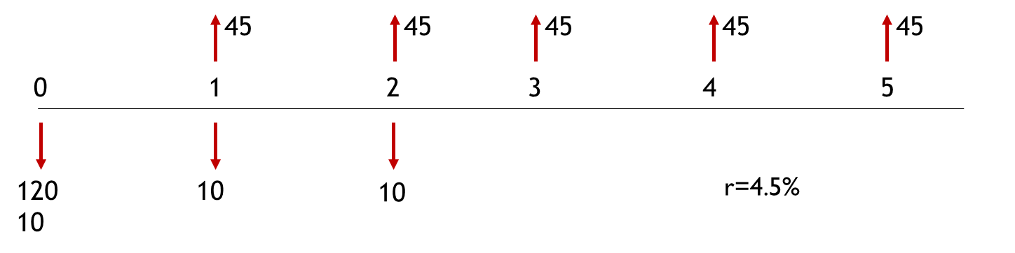
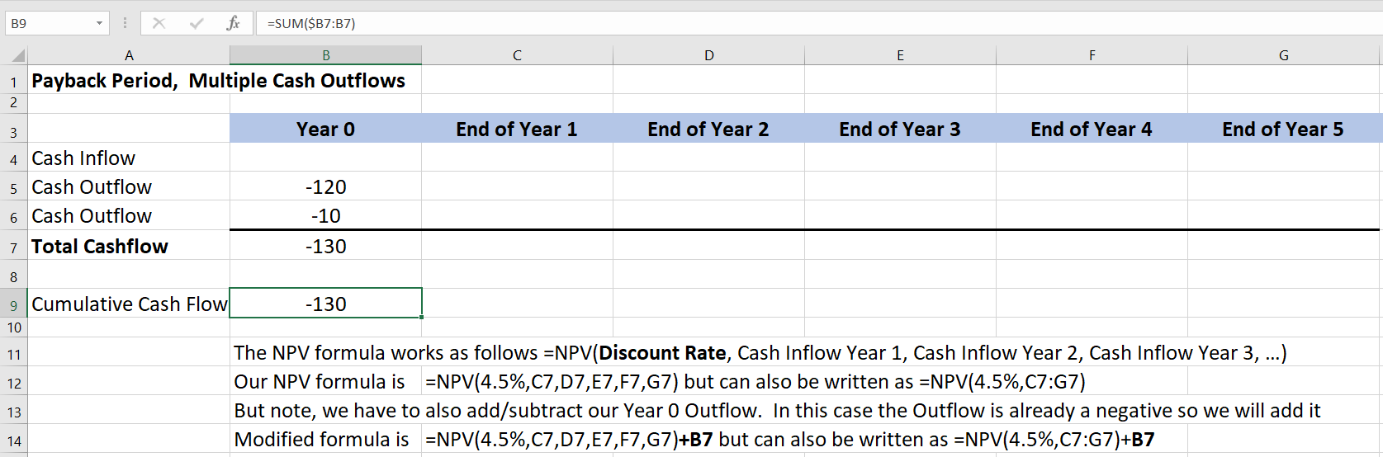
2. Net present value exercise with multiple outflows
Let’s try calculating NPV using Excel and the NPV formula. Use the screenshot below to build an Excel file, Column B is already done.
The NPV formula works as follows =NPV(Discount Rate, Cash Inflow Year 1, Cash Inflow Year 2, Cash Inflow Year 3, …). But note, we have to add/subtract the Year 0 outflow to the formula.

Slide 30
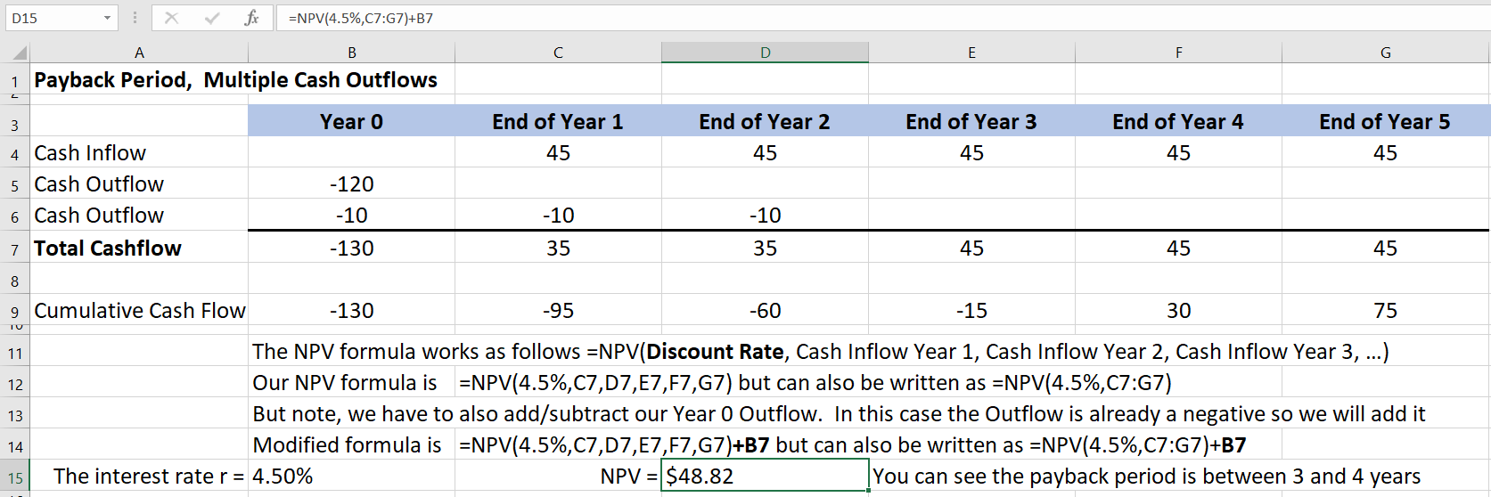
2. Net present value exercise with multiple outflows
45
45
45
45
45
0
1
2
3
4
5
120
10
10
10
r=4.5%

Slide 31
Next module
We will continue benefit-to-cost (financial) analysis:
Internal rate of return (IRR)
Benefit - Cost Analysis (CBA)

Slide 32
Homework and evaluations
Readings (and other material) for next module as listed in Course Overview
Project Selection Quiz – see FOL

Slide 33
references
Project Management Institute (2017). A Guide to the Project Management Body of Knowledge (Sixth Edition).
Kerzner, Harold (2017). Project Management, Twelfth Edition.
Watts, A. (2014). Project Management. Victoria, B.C.:BCcampus. Retrieved from https://opentextbc.ca/projectmanagement/.

